Slide 1


Slide 2
What is CloudHour?
Objective of CloudHour
Round-table discussion
Focus on a few key topics
Why It's Important
Rapid changes in cloud security and tech
Stay updated and connected for growth as community
How it will benefit the community
Real-time engagement with hosts and community members
Ask open questions and speak your opinion
Opportunity to affect the next agenda
Notes:
Objective of CloudHour
The objective of CloudHour is to create a collaborative space where professionals can come together to discuss, learn, and share insights on the most pressing topics in cloud security and modern workplace technology.
Why its important
CloudHour is important because, in the rapidly evolving landscape of cloud security and workplace technologies, staying updated and connected is crucial for career growth and organizational resilience
How it will benefit the community
By attending CloudHour, community members will have the unique opportunity to engage with industry experts in real-time, ask questions, network with like-minded professionals, and even have the chance to contribute their own expertise by becoming guest speakers in future episodes.

Slide 3

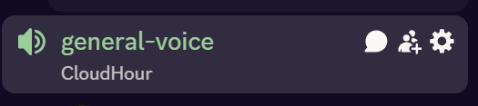
If you prefer to not talk or be asked questions press mute
press mute just mute the mic
If you preferer to chat press

Slide 4
Links to share
Taskbar and Start Menu customization by Michael Frank
M365 License Assignment Report by RK Solutions
QuickPIM a multi-role PIM activation by Daniel Bradley
Intune 'fast lane' - Let's talk about all things latenc
Understanding tokens in Microsoft Entra ID
Notes:
https://michaelsendpoint.com/intune/customize_taskbar_startmenu.html
https://rksolutions.nl/m365-license-assignment-report/
https://ourcloudnetwork.com/quickpim-a-multi-role-pim-activation-extension-for-google-chrome/
https://techcommunity.microsoft.com/event/microsoftintuneevents/intune-fast-lane---lets-talk-about-all-things-latency/4376201
https://learn.microsoft.com/en-us/entra/identity/devices/concept-tokens-microsoft-entra-id

Slide 5
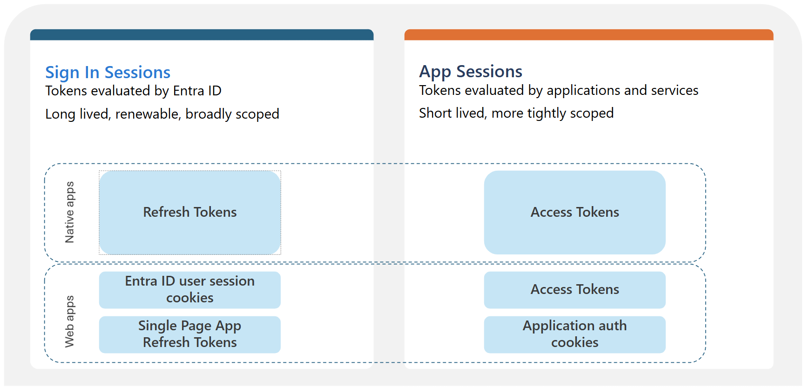
Understanding tokens in Microsoft Entra ID
Notes:
https://learn.microsoft.com/en-us/entra/identity/devices/concept-tokens-microsoft-entra-id

Slide 6
Agenda
State of the server
Insider Risk
Agent Intune / Entra
CIS Benchmark v4.0.0 for Intune (Win11)
Microsoft announces new European digital commitments
Getting started with LAPS
Upcoming deprecations

Slide 7
State of the server
Gaming evenings could that be fun? (free games like, Jackbox, Among us, Golf)
How do you think Spotlight is going so far?
How do you think CloudHour is going so far?
How is the layout on the server?
Open Feedback

Slide 8
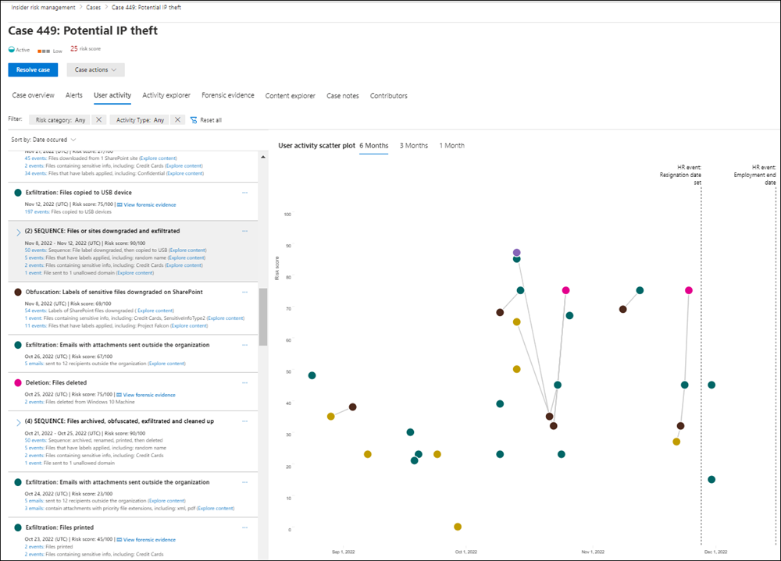
Insider Risk
Detects and responds to insider threats like data leaks, IP theft, and policy violations
Built with privacy by design: pseudonymized users, role-based access, audit logs
Uses Microsoft 365 signals and Defender for Endpoint for real-time risk detection
Includes policy templates, alerting, investigation tools, and optional forensic evidence
Available in Microsoft 365 E5 or via a 90-day trial to explore full capabilities
Notes:
https://learn.microsoft.com/en-us/purview/insider-risk-management
https://learn.microsoft.com/en-us/training/paths/m365-manage-insider-privacy-risk/

Slide 9
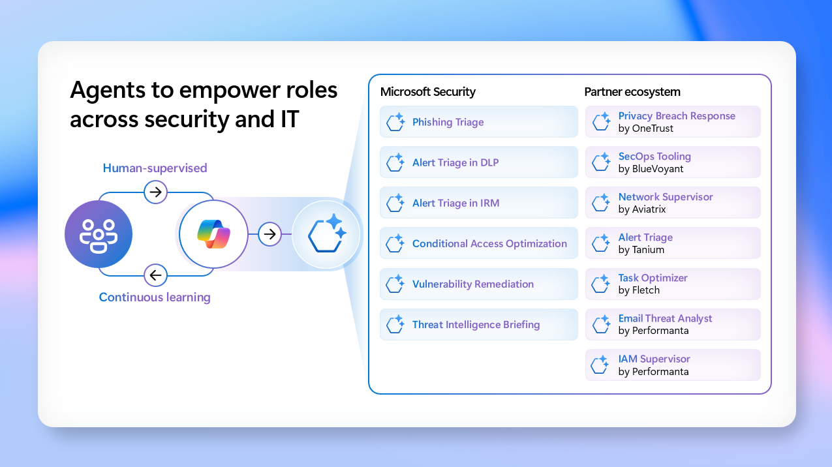
Agents, its evolving and Microsoft is pushing it forward
Conditional Access Optimization Agent in Microsoft Entra
Monitors for new users or apps not covered by existing policies, identifies necessary updates to close security gaps, and recommends quick fixes for identity teams to apply with a single click.
Vulnerability Remediation Agent in Microsoft Intune
Monitors for new users or apps not covered by existing policies, identifies necessary updates to close security gaps, and recommends quick fixes for identity teams to apply with a single click.
Threat Intelligence Briefing Agent in Security Copilot
Automatically curates relevant and timely threat intelligence based on an organization’s unique attributes and cyberthreat exposure.
Notes:
https://techcommunity.microsoft.com/blog/securitycopilotblog/rsa-conference-2025-security-copilot-agents-now-in-preview/4406797

Slide 10
CIS Benchmark v4.0.0 for Intune (Win11)
Apply their best practices for configuring Windows 11 devices using Microsoft Intune
Enhanced Security Recommendations to allign with Win11
Pre-configured JSON Files (🚀), easy import to Intune
Policy-Based Configuration, recommended be configured in the tenant

Slide 11

Microsoft announces new European digital commitments
Massive Expansion of Cloud and AI Infrastructure Microsoft will expand datacenter operations in 16 countries and boost capacity by 40%, supporting local innovation, sovereignty, and compliance.
Upholding Digital Resilience in Times of Geopolitical Uncertainty Microsoft commits to keeping European cloud services running under European law, even in the face of foreign government pressure.
Strengthening Data Privacy and Sovereignty Completion of the EU Data Boundary ensures EU customers can keep all data—including support data—within the EU and EFTA regions.
Leading in Cybersecurity Across Europe Microsoft will appoint a Deputy CISO for Europe, comply with new EU cybersecurity laws, and provide continued support for national resilience.
Fueling Economic Competitiveness and Open Source Innovation Through open AI platforms and support for startups, Microsoft enables growth and choice in Europe’s digital economy.

Slide 12
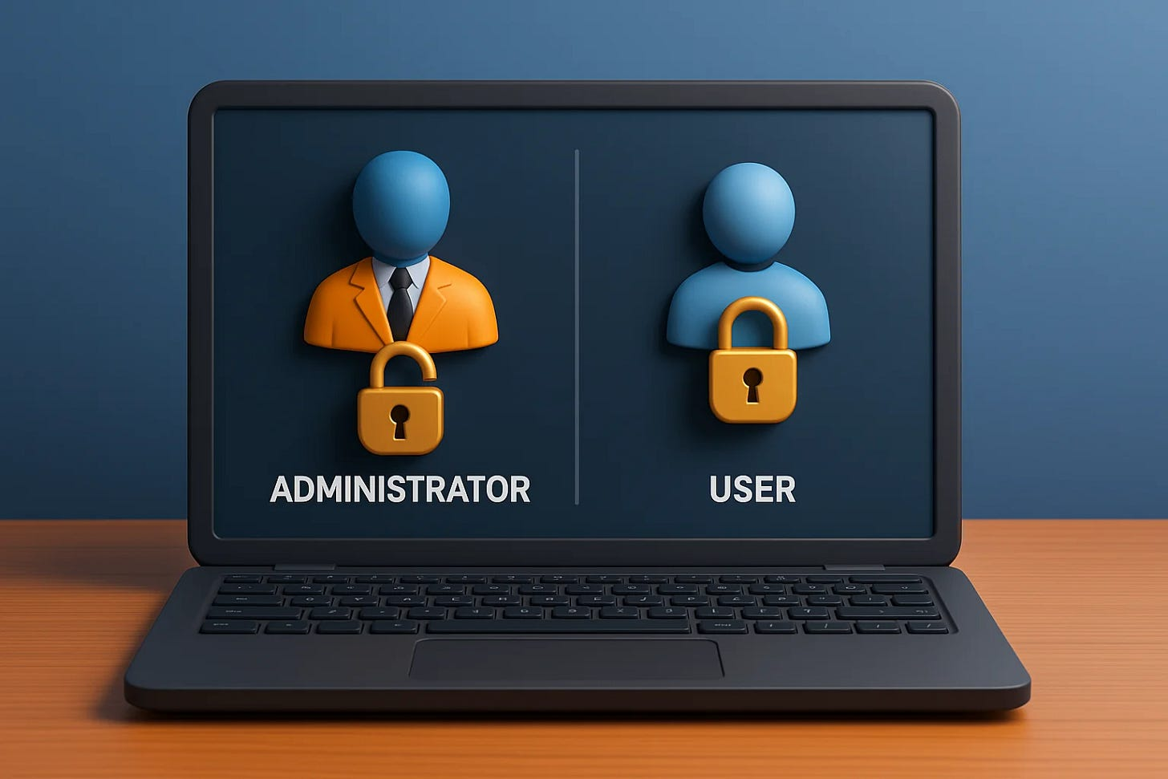

Getting started with LAPS by Joël Prins ❤️
Modern Admin Control: With Endpoint Privilege Management and the right Intune setup, local admin rights are no longer essential by default—but still need tight control.
Structured Group Management
Device and user groups (dynamic and static) are the backbone of this setup, supporting a “secure by default” approach and simplifying admin assignment.
Entra Integration
Scoped admin access ensures only the device owner gets local admin rights during setup, reducing lateral movement risk and preventing Global Admins from being added.
Granular Control via Intune
Local user group membership policies using Replace actions provide consistent and secure admin assignments across devices.
Security Enhancements
Leverage LAPS with randomized account names, disable default Administrator, and enable Config Refresh to tighten control without losing manageability.
Notes:
https://intothecloud.eu/p/local-admin-segmentation

Slide 13
Deprecations by Katos ❤️
Microsoft 365 Apps on WS 2016/2019
Ends Oct 2025 – Move to Windows 365 or AVD.
Office 365 Connectors in Teams
Retires end of 2025 – Use Workflows app.
OneNote for Windows 10
Ends Oct 14, 2025 – Switch to new OneNote or Loop.
Office 2016 & 2019
Support ends Oct 14, 2025 – Upgrade to M365 Apps.
Legacy MFA & SSPR Policies
Ends Sep 30, 2025 – Use Entra Auth Methods policy.
Classic Teams App
Ends July 1, 2025 – Move to new Teams app.

Slide 14
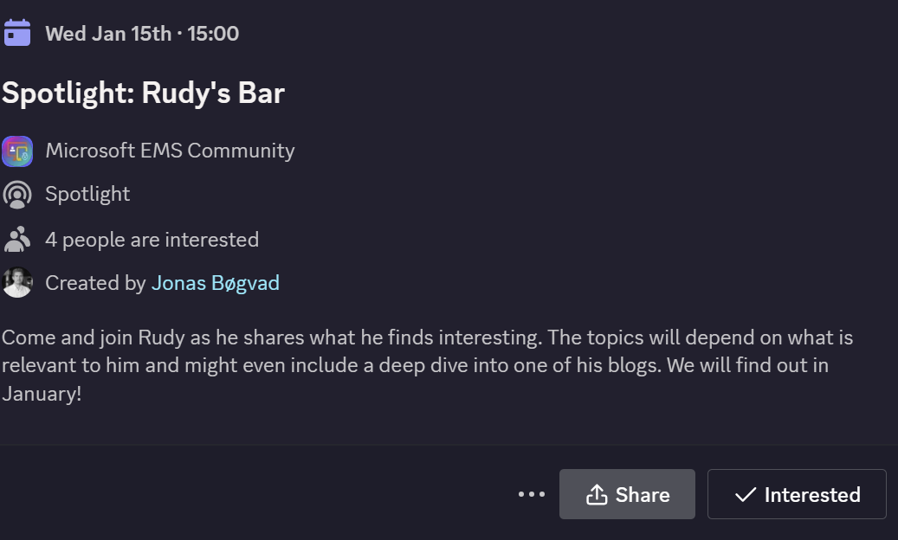
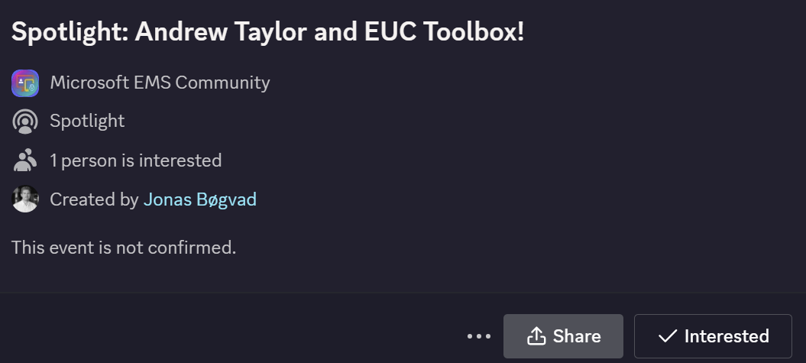
Spotlights sessions
OSD Cloud​
IntuneCD​ (awaiting confirmation on date)
Rudy Webinar ​
Johan Arwidmark ​
Purav (In contact)
Kelvin from CIPP ​
Andrew Taylor and EUC Toolbox (Confirmed)
TUGI tool (Confirmed)
Somesh Pathek (Confirmed)
WinTuner Stephan van Rooji (In contact)
IntuneCD Tobias (In contact)

Slide 15
Upcoming spotlight events!
Show in discord

